Slide 1

ARE CFIS STILL RELEVANT IN MORDEN DAY SA?
4th
CFI
INDABA
15 OCTOBER 2014
PRESENTER:
OLAOTSE MATSHANE

Slide 2

THE BIG QUESTIONS?
Are CFIs still relevant in modern day SA?
2) Why is the Sector not growing? And what can be done to grow the sector?
3) Is it time to rethink the CFI business model?

Slide 3
IS THE CFI MODEL STILL RELEVANT?
COMMERCIAL BANKS – PROFIT AT ALL COST
EXPLOITATION OF LOW INCOME CONSUMERS
THE “HIDDEN” ECONOMY

Slide 4

PROFIT AT ALL COST!!!
R65bn
R56bn
R49bn
Profit of the big 5 – last 3 years

Slide 5

PROFIT AT ALL COST!!!
R1.57 trillion
gross debtors book
Total outstanding unsecured credit
2007 - R41bn
2012 – R159bn
June 2014 – 172bn
320%
NCR: Consumer Credit Market report – June 2014

Slide 6

TREE OF BANK CHARGES
Notification fee
Cash Deposit fee
Administration fee
Withdrawal
Bounced debit order
Branch trans
X2

Slide 7

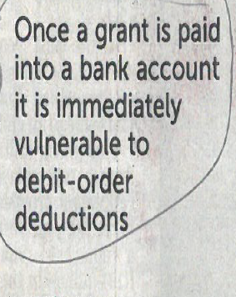
EXPLOITATION OF CONSUMERS
ST – Business times – 28 Sept 2014

Slide 8
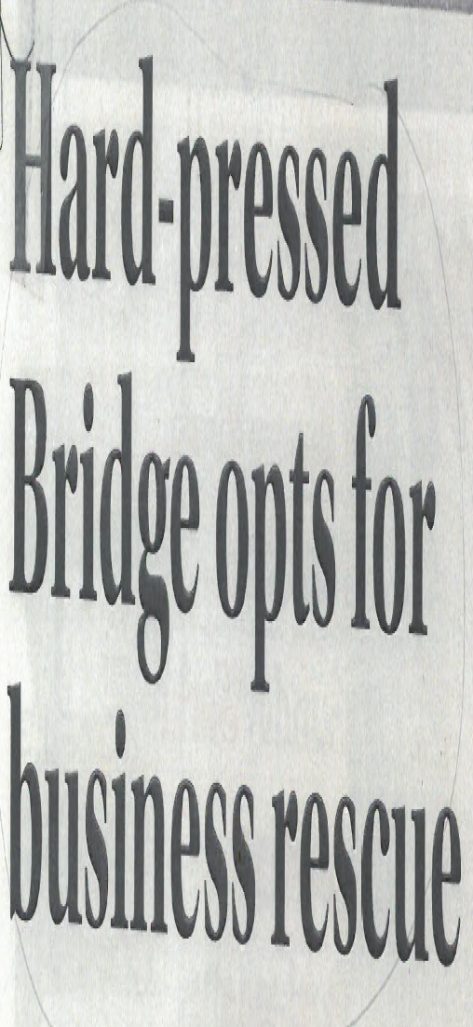

EXPLOITATION OF CONSUMERS
One Bridge Customer
Borrowed – R5 847
Repaid – R26 479
Still owes – R10 442
Total repayment – 3 yrs – R38 000
ST – Business Times 28 Sep 2014

Slide 9
EXPLOITATION OF CONSUMERS
Abuse – consumer credit insurance
Credit Transaction
Cost of credit insurance
Loan - R2500
Interest – R893.42
Credit insurance – (R50.79x 24) = R1 218
Initiation fee + monthly service fee
20% of total repayable amount
Almost 50% of loan amount
Source – National Treasury, Finmark Trust & FSB: 2014

Slide 10


THE “HIDDEN” ECONOMY
Drivers of Economic growth
Drivers of job creation > big business
Plethora of Gov Incentives
COST & ACCESS TO FINANCE STILL A MAJOR CHALLENGE!!!

Slide 11
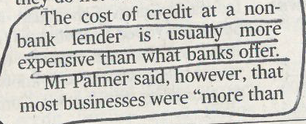
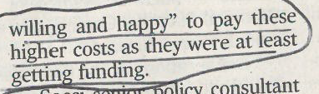

Slide 12
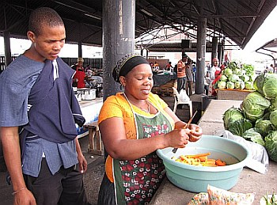
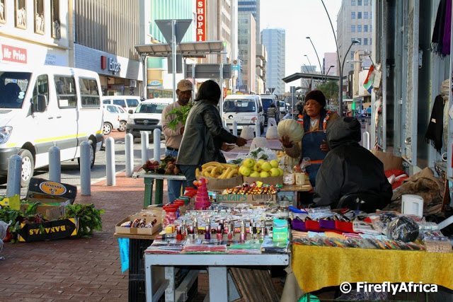

Slide 13
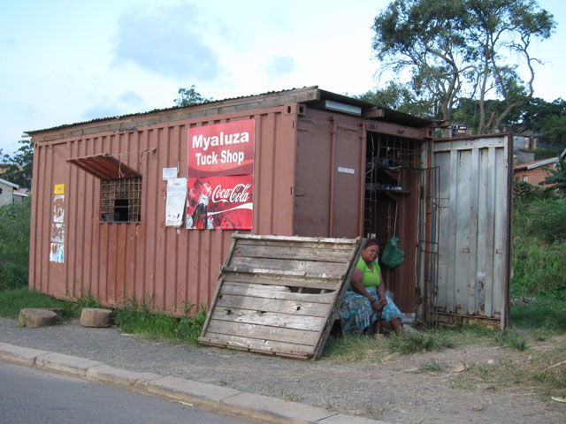
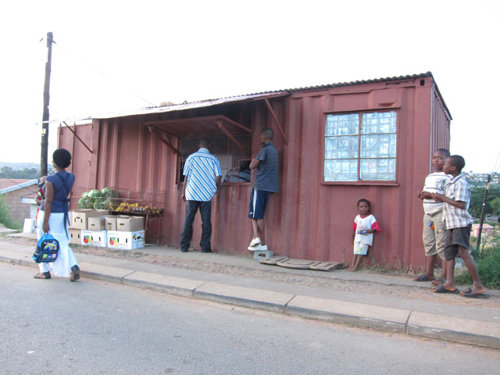
Spaza Shops
+/- 100 000
Turnover R7bn pa
Employs 2 to 3 people
Support av – 4 family members
www.spazanews.co.za

Slide 14
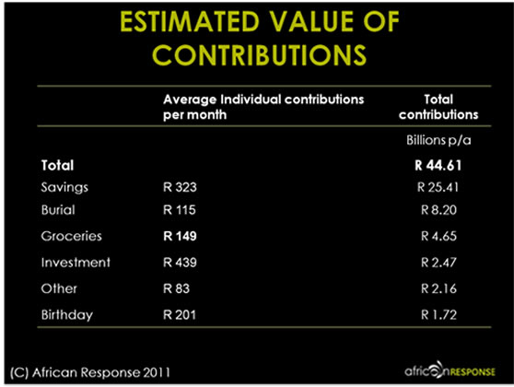
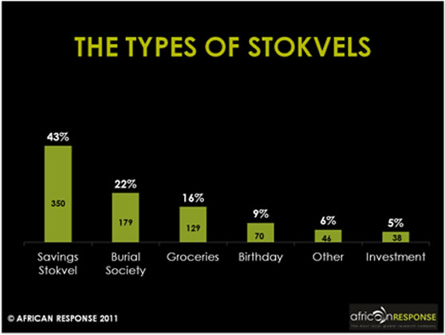
Stokvels
R44 bn ??
formal banking sector ?
R44 bn ??
OR under the mattress?

Slide 15
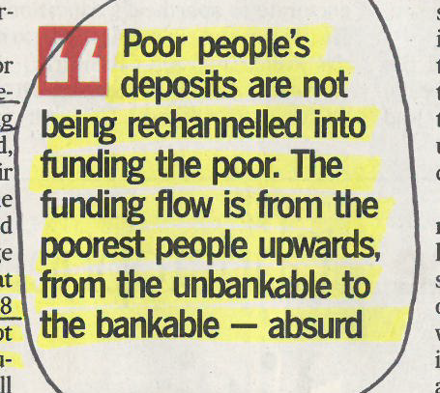
EXPLOITATION OF CONSUMERS
Business Day 14 July 2014

Slide 16

FOOD FOR THOUGTHT
Are CFIs still relevant?
CFI model in its current state still relevant?
Can the sector grow?
Where are the growth areas/opportunities ?
Potential areas for innovation?
Sector acting as a collective? And engaging enough with key stakeholders on pertinent issues?
Regulation
Model
Other issue

